Slide 1


Shaun Cruz
March 14 2022

Slide 2

Outline
Executive Summary
Introduction
Methodology
Results
Conclusion
Appendix

Slide 3
Executive Summary
Summary of methodologies
All methods performed using Python scripts
Data Collection through API and Web Scraping
Exploratory Data Analysis (EDA) via Data Wrangling, SQL, and Data Visualization
Visual Analytics interactively via Folium and Plotly Dash Dashboard
Machine Learning Prediction using scikit-learn (Support Vector Machines, Classification Trees, and Logistic Regression)
Summary of all results
KSC LC-39A had the best success rate
Orbits ES-L1, GEO, HEO, SSO, VLEO had best success rate
Lighter payloads have higher success rate
All models predict the same, but the decision tree classifier worked best on the validation data

Slide 4
Introduction
Project background and context
SpaceX Falcon 9 rocket launches cost 62 million dollars/launch vs Other providers at 165 million dollars/launch
Savings are due to reuse of the first stage.
If you can predict if SpaceX Falcon first stage will land, you can determine the total cost of SpaceX Falcon launch → Can other provider bid against SpaceX?
Problems you want to find answers
Ultimate goal: Will the Falcon 9 first stage land successfully?
What factors (launch sites, payloads, F9 booster versions, etc.) affect success rate of launch?
Where are Launch sites located (in proximity to)?
What prediction model performs best: Support Vector Machines, Classification Trees, or Logistic Regression?

Slide 5

Section 1

Slide 6
Methodology
Executive Summary
Data collection methodology:
SpaceX API and Wikipedia (web scraping)
Perform data wrangling
Data was cleaned and one-hot encoding was used on particular features
Perform exploratory data analysis (EDA) using visualization and SQL
Perform interactive visual analytics using Folium and Plotly Dash
Perform predictive analysis using classification models
How to build, tune, evaluate classification models

Slide 7
Data Collection
SpaceX API
Requested from "https://api.spacexdata.com/v4/launches/past"
Requested and parsed JSON results using GET request
Decoded and turned into Pandas dataframe
Partitioned data into lists (BoosterVersion, PayloadMass, Orbit, etc.)
Combined all data into a dictionary, and filtered for only Falcon 9 launches
Cleaned data for any accordingly.
Webscraping
Grabbed data from https://en.wikipedia.org/wiki/List_of_Falcon\_9\_and_Falcon_Heavy_launches
Specifically from 9th June 2021 (https://en.wikipedia.org/w/index.php?title=List_of_Falcon_9_and_Falcon_Heavy_launches&oldid=1027686922)
Used BeautifulSoup to extract and format data into dataframe, and converted into CSV

Slide 8
Data Collection – SpaceX API
Request data via API url
Clean data
Convert json results to data frame
GitHub URL: https://github.com/shauncruz312/IBM-Data-Science-Capstone/blob/eb357d03a03f8baf950af4ca9168a611a3ad3e08/Data%20Collection%20API.ipynb

Slide 9
Data Collection - Scraping
Get data from Wiki URL
Parse HTML to crate dataframe
Use BeautifulSoup to create object from HTML
Create CSV from Dataframe
GitHub URL: https://github.com/shauncruz312/IBM-Data-Science-Capstone/blob/eb357d03a03f8baf950af4ca9168a611a3ad3e08/Data%20Collection%20with%20Web%20Scraping.ipynb

Slide 10
Data Wrangling
Calculate % of missing values for attributes
Calculate:
Identify column types
Create a landing outcome label from Outcome column
Launches on each site
Number and Occurrence of each orbit
Number and Occurrence of mission outcome per orbit type
GitHub URL: https://github.com/shauncruz312/IBM-Data-Science-Capstone/blob/eb357d03a03f8baf950af4ca9168a611a3ad3e08/EDA.ipynb

Slide 11
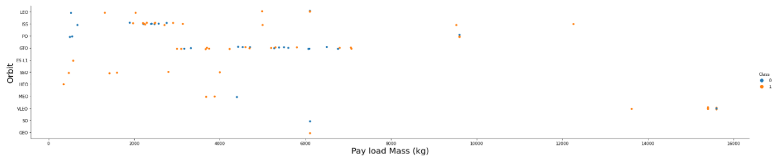
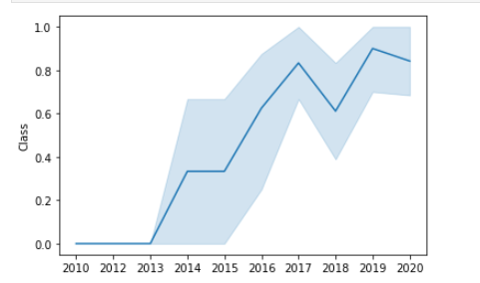
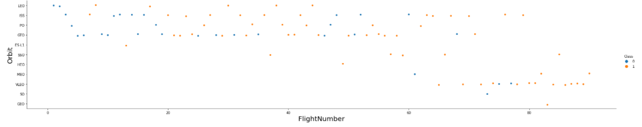
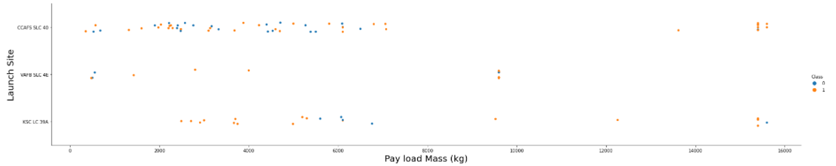
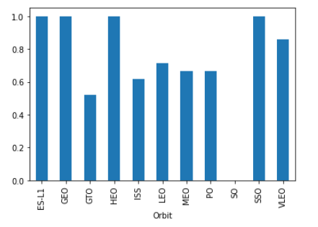
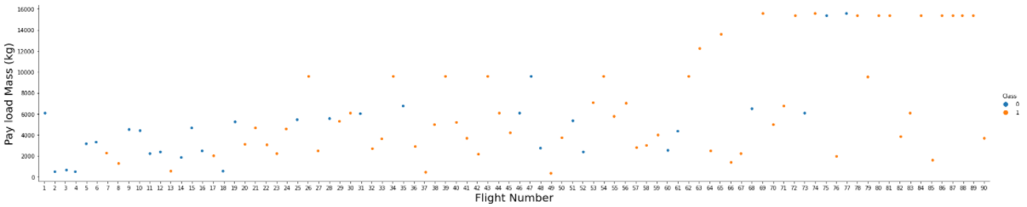
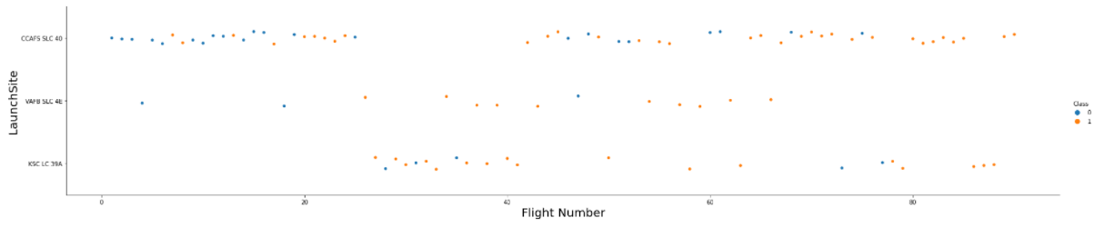
EDA with Data Visualization
Various Plots made:
FlightNumber vs Payload Mass
FlightNumber vs LaunchSite
Payload vs LaunchSite
FlightNumber vs Orbit Type
Payload vs Orbit Type
Launch and Orbit Success Rate
All plots to identify what features led to positive orbit/launch rate
GitHub URL: https://github.com/shauncruz312/IBM-Data-Science-Capstone/blob/eb357d03a03f8baf950af4ca9168a611a3ad3e08/EDA%20with%20Visualization.ipynb
Launch Success Rate
Orbit Success Rate

Slide 12
EDA with SQL
SQL queries performed
SELECT * FROM HTB11006.SPACEXTBL LIMIT 5
SELECT DISTINCT(launch_site) FROM HTB11006.SPACEXTBL
SELECT DISTINCT(launch_site) FROM HTB11006.SPACEXTBL WHERE launch_site LIKE 'CCA%’
SELECT SUM(payload_mass__kg_) as total_payload_mass FROM HTB11006.SPACEXTBL WHERE CUSTOMER='NASA (CRS)’
SELECT AVG(payload_mass__kg_) as avg_payload_mass FROM HTB11006.SPACEXTBL WHERE BOOSTER_VERSION='F9 v1.1’
SELECT min(DATE) as min_date FROM HTB11006.SPACEXTBL WHERE LANDING__OUTCOME = 'Success (ground pad)’
SELECT BOOSTER_VERSION FROM HTB11006.SPACEXTBL WHERE LANDING__OUTCOME = 'Success (drone ship)' AND payload_mass__kg_ > 4000 AND payload_mass__kg_<6000
SELECT MISSION_OUTCOME, COUNT(*) as tot_num_missions FROM HTB11006.SPACEXTBL GROUP BY MISSION_OUTCOME
SELECT BOOSTER_VERSION, PAYLOAD_MASS__KG_ FROM HTB11006.SPACEXTBL WHERE PAYLOAD_MASS__KG_ = (select max(PAYLOAD_MASS__KG_) from HTB11006.SPACEXTBL)
SELECT LANDING__OUTCOME, BOOSTER_VERSION, LAUNCH_SITE FROM HTB11006.SPACEXTBL WHERE LANDING__OUTCOME = 'Failure (drone ship)' AND DATE LIKE '2015%’
SELECT LANDING__OUTCOME, count(*) as num_outcomes FROM (SELECT * FROM HTB11006.SPACEXTBL WHERE DATE BETWEEN '2010-06-04' AND '2017-03-20') GROUP BY LANDING__OUTCOME ORDER BY num_outcomes DESC
GitHub URL: https://github.com/shauncruz312/IBM-Data-Science-Capstone/blob/eb357d03a03f8baf950af4ca9168a611a3ad3e08/EDA%20with%20SQL.ipynb

Slide 13
Build an Interactive Map with Folium
Marked launch sites with success/failure indications
Assigned launch outcomes (failure=0, 1=success)
Identified what sites have high success rate for launches
Calculated distances between launch site to coastline, city, railroad, and highway
Launch sites are always near railroads, highways, and coastlines
Launch sites are away from cities.
GitHub URL: https://github.com/shauncruz312/IBM-Data-Science-Capstone/blob/eb357d03a03f8baf950af4ca9168a611a3ad3e08/Interactive%20Visual%20Analytics%20with%20Folium.ipynb
IBM URL (since Folium doesn’t work in GIT) https://dataplatform.cloud.ibm.com/analytics/notebooks/v2/467fb4d0-9937-4d9f-8cbe-7294c408d3b9/view?access_token=fb58eddd8633997dc703a5bc1eb2c692eda0ba12a0e847a7e9e8cbf565129509

Slide 14
Build a Dashboard with Plotly Dash
Pie chart showing total launch by site
Scatter plot of Outcome vs Payload Mass for different Booster Versions
This gives us an understanding of successes and locations
GitHub URLS:
https://github.com/shauncruz312/IBM-Data-Science-Capstone/blob/eb357d03a03f8baf950af4ca9168a611a3ad3e08/spacex_dash_app.py
https://github.com/shauncruz312/IBM-Data-Science-Capstone/blob/eb357d03a03f8baf950af4ca9168a611a3ad3e08/SpaceXLaunchREcordsDashboard.PNG

Slide 15
Predictive Analysis (Classification)
Load Data and standardize
Train/Test and calculate accuracy (and Confusion Plot) for Logistic Regression, SVM, and Classification Tree, and KNN
Split data into training/test data
Compare Results
GitHub URL: https://github.com/shauncruz312/IBM-Data-Science-Capstone/blob/eb357d03a03f8baf950af4ca9168a611a3ad3e08/Machine%20Learning%20Prediction.ipynb

Slide 16
Results
Exploratory data analysis results
Interactive analytics demo in screenshots
Predictive analysis results

Slide 17

Section 2

Slide 18
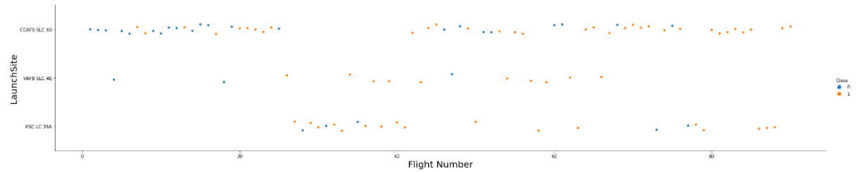
Flight Number vs. Launch Site
The higher the flight numbers at CCAFS SLC 40, the more successful. KSC LC 39A and VAFB SLC 4E generally had good success rate, but smaller sample size

Slide 19
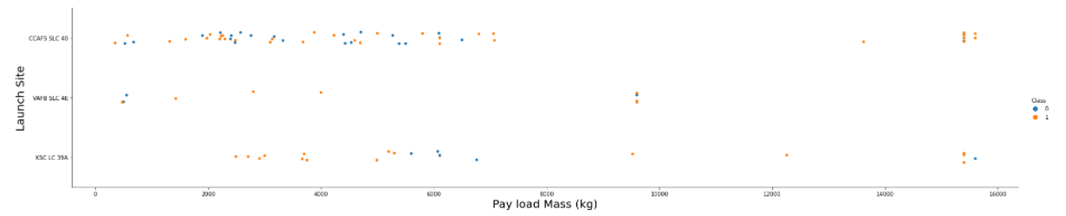
Payload vs. Launch Site
No rockets launched for heavypayload mass(greater than 10000).

Slide 20
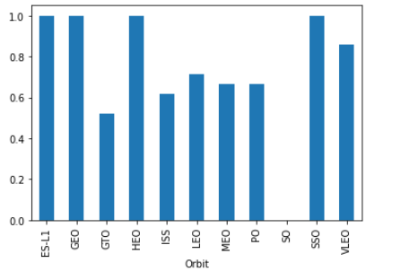
Success Rate vs. Orbit Type
ES-L1, GEO, HEO, and SSO have the highest success rate.

Slide 21
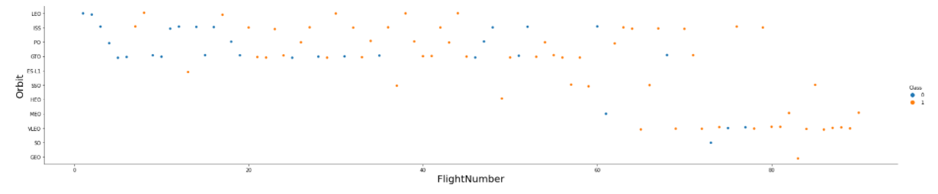
Flight Number vs. Orbit Type
the LEO orbit the Success appears related to the number of flights; on the other hand, there seems to be no relationship between flight number when in GTO orbit.

Slide 22
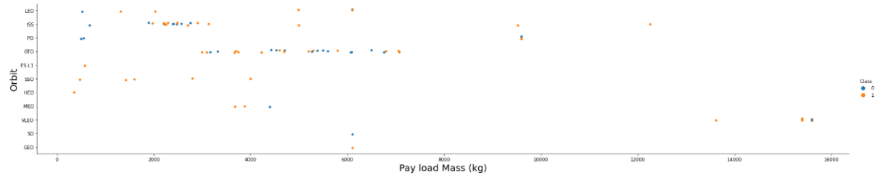
Payload vs. Orbit Type
With heavy payloads the successful landing or positive landing rate are more for Polar,LEO and ISS.
However for GTO we cannot distinguish this well as both positive landing rate and negative landing(unsuccessful mission) are both there here.

Slide 23
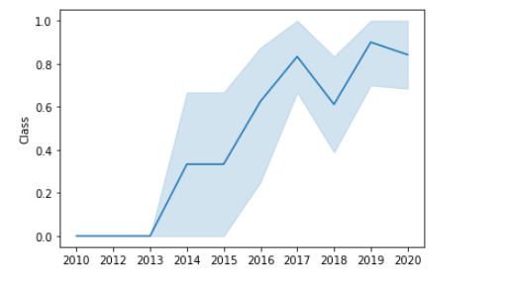
Launch Success Yearly Trend
the sucess rate since 2013 kept increasing till 2020

Slide 24
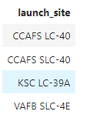
All Launch Site Names
SELECT DISTINCT(launch_site) FROM HTB11006.SPACEXTBL
Distinct(launch_site) only shows unique names from the table

Slide 25
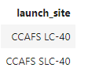
Launch Site Names Begin with 'CCA'
SELECT DISTINCT(launch_site) FROM HTB11006.SPACEXTBL WHERE launch_site LIKE 'CCA%’
Adding “LIKE ‘CCA%’ chooses launch site names starting with CCA. In order to choose 5 records, remove “DISTINCT” and add LIMIT=5 after WHERE.

Slide 26
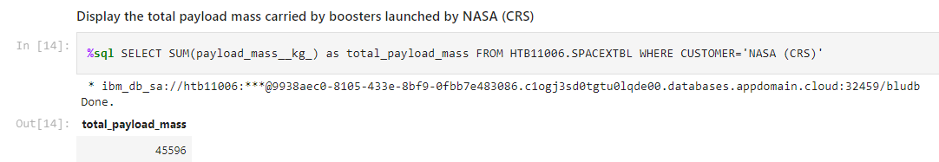
Total Payload Mass
Find customer = NASA (CRS) and sum the payload to get the total

Slide 27
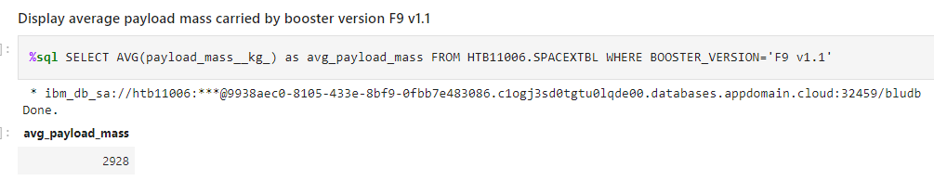
Average Payload Mass by F9 v1.1
Find where Booster is ‘F9 v1.2’ and then average the payload mass of the results

Slide 28
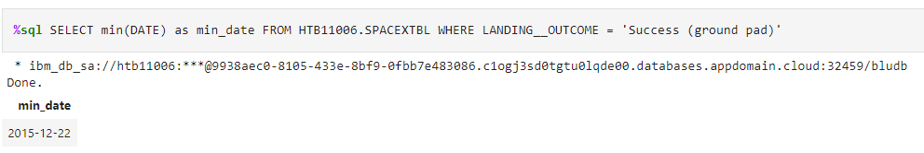
First Successful Ground Landing Date
Look for when “Success (ground pad)” was the LANDING_OUTCOME, and find the earliest date.

Slide 29
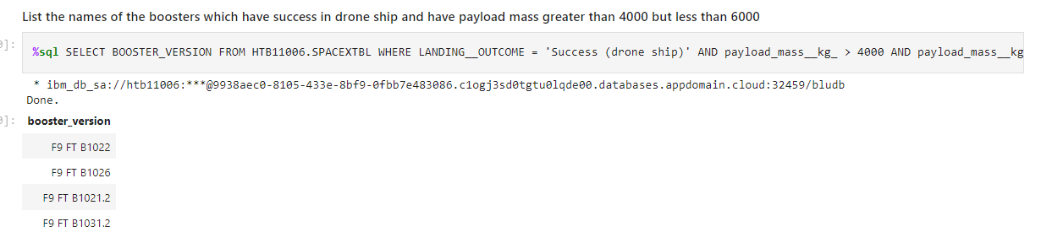
Successful Drone Ship Landing with Payload between 4000 and 6000
List the names of boosters which have successfully landed on drone ship and had payload mass greater than 4000 but less than 6000
Present your query result with a short explanation here

Slide 30
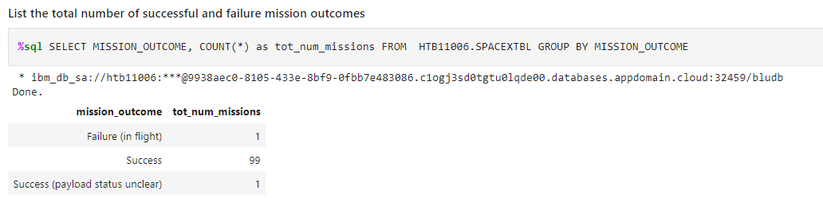
Total Number of Successful and Failure Mission Outcomes
Group by mission outcome and then count the amounts to get total numbers

Slide 31
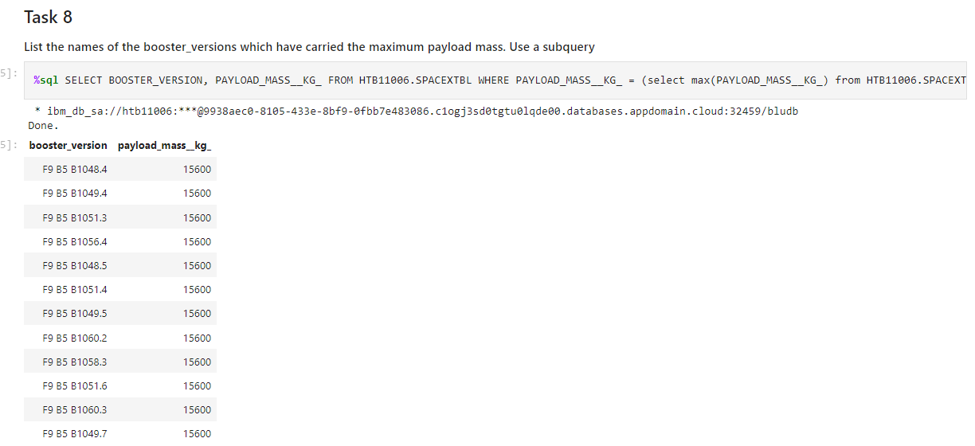
Boosters Carried Maximum Payload
%sql SELECT BOOSTER_VERSION, PAYLOAD_MASS__KG_ FROM HTB11006.SPACEXTBL WHERE PAYLOAD_MASS__KG_ = (select max(PAYLOAD_MASS__KG_) from HTB11006.SPACEXTBL)
Create a subquery for maximum payload mass and select the booster version from subquery to see which boosters have carried the max payload.

Slide 32
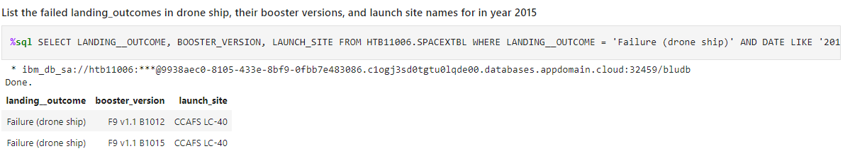
2015 Launch Records
Choose 2015 as date failure as outcome, and list the outcome and booster version and launch site

Slide 33
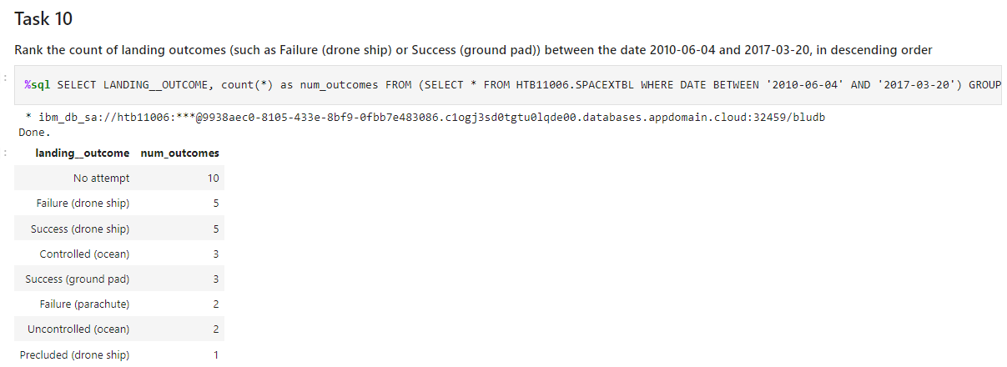
Rank Landing Outcomes Between 2010-06-04 and 2017-03-20
Create sub query of dates between June 4 2010 and March 20 2017, and then rank the counts of each outcome.

Slide 34

Section 3

Slide 35
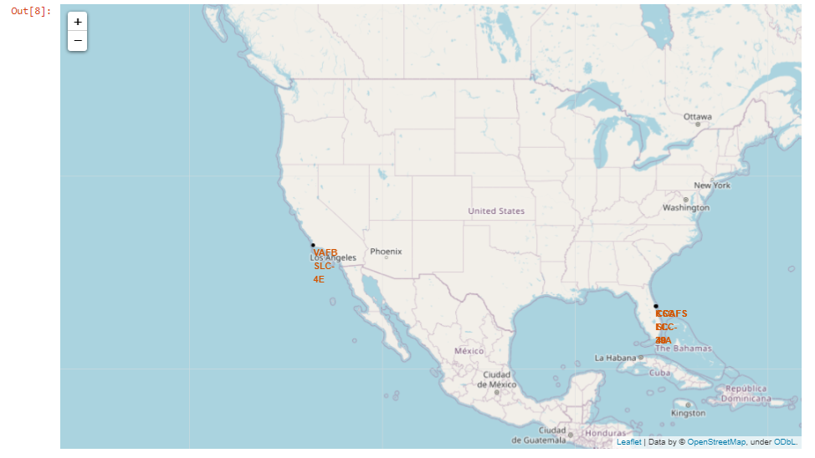
Launch Sites Locations on Global Map
Are all launch sites in proximity to the Equator line?
No, none of the sites are in proximity to the Equator line. Florida has the lowest ones and that isnt near the equator.
Are all launch sites in very close proximity to the coast?
Yes, all launch sites are in proximity to the coast, they are on teh border of Florida and California.

Slide 36
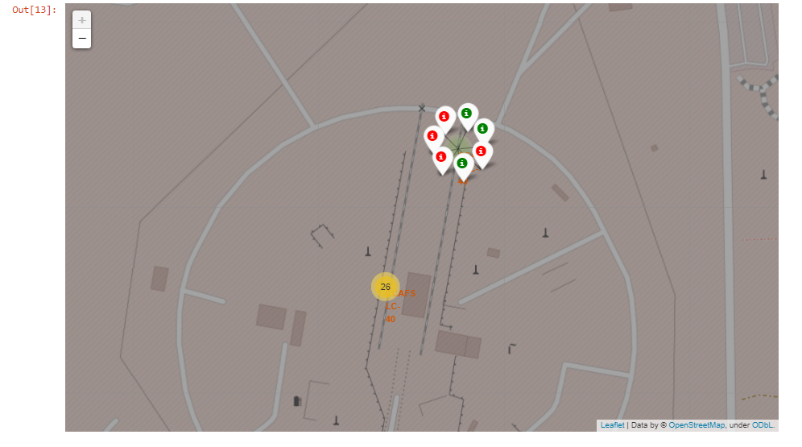
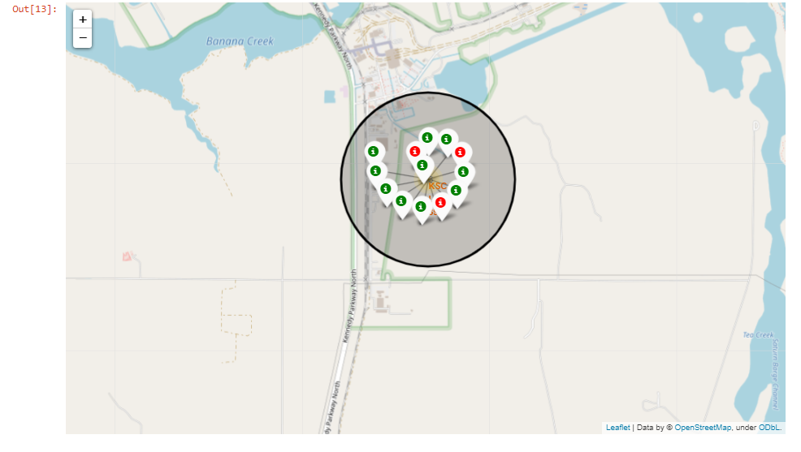
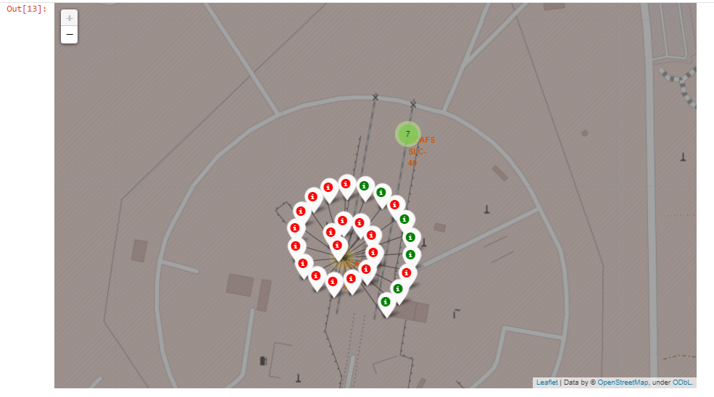
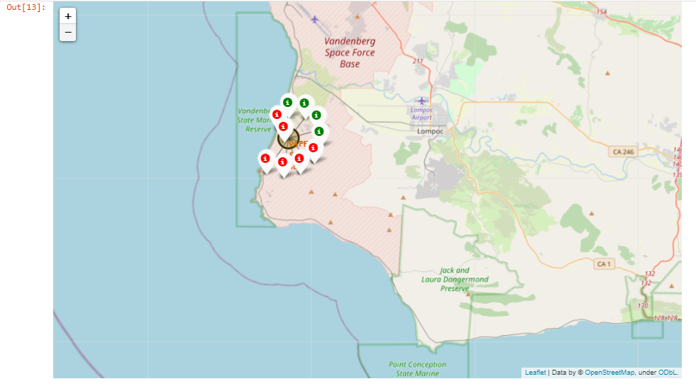
Color Labled Launch Outcomes
Green is successful, Red is failure.

Slide 37
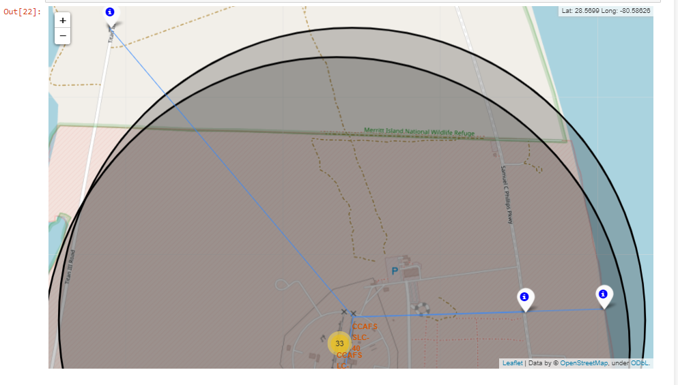
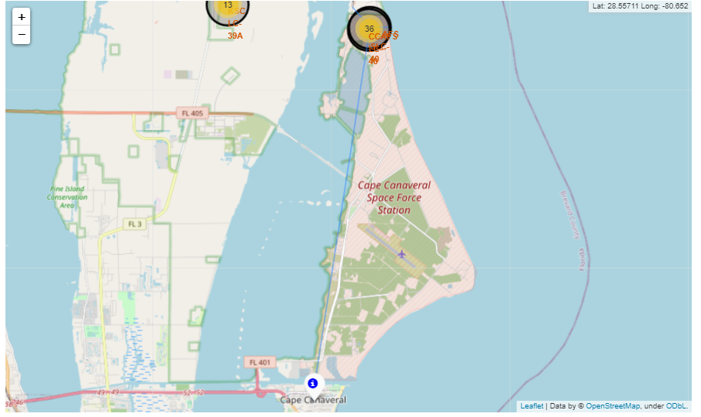
CCAFS Distance to Railway, Highway, Coastline, and City
Distance to
Railway: 1.291
Highway: 05824
Coastline: 0.8513
City: 18.2044
Close to railway, highway, coastline, FAR from city

Slide 38

Section 4

Slide 39
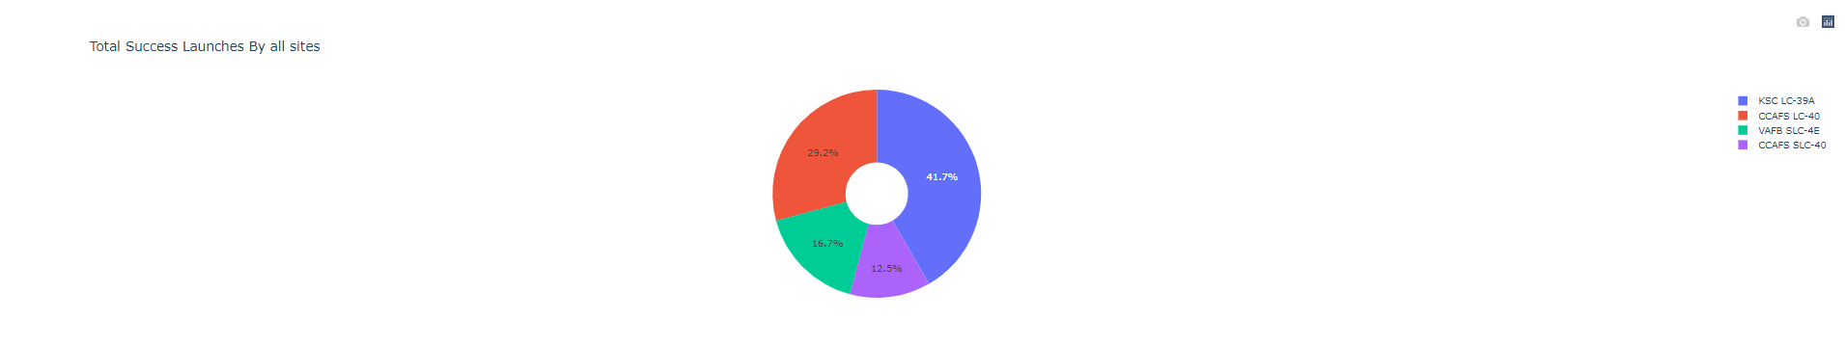
Launch Success Count (PieChart)
KSC LC-39A has highest success rate

Slide 40
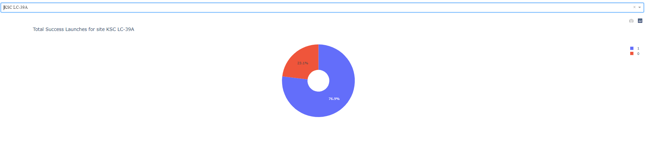
Launchsite with Highest Success Ratio (KSC LC 39A)
KSC LC 39A had 23.1% Failures and 76.9% Successes

Slide 41
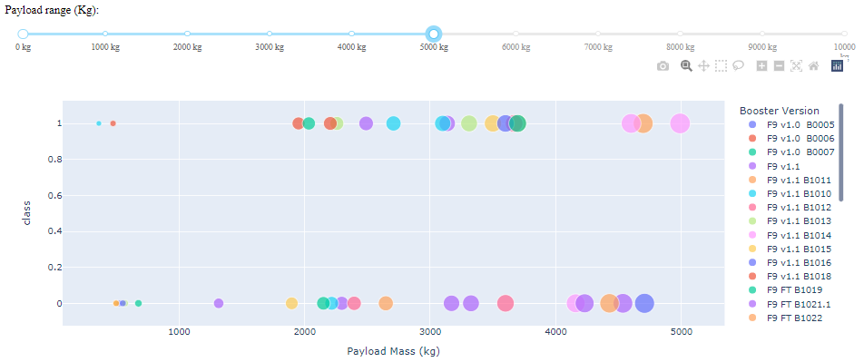
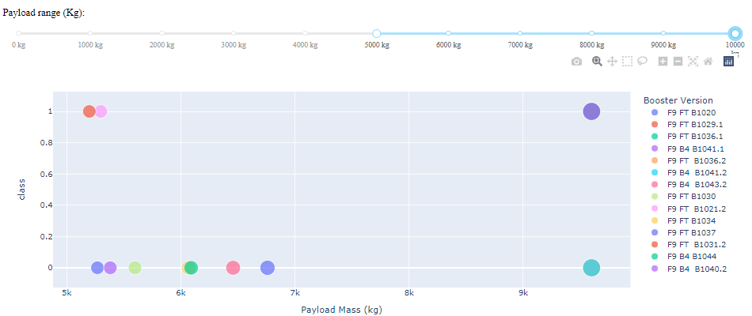
Payload vs Launch Outcome scatter plots
TOP: 0kg-5000kg
Right: 5000kg-10000kg
Shows better success rate for lower payload mass

Slide 42

Section 5

Slide 43
Classification Accuracy
Logistic Regression Accuracy
Validation data: 0.8464
Test data: 0.8333
SVM Accuracy
Validation Data: 0.84821
Test data: 0.8333
Decision Tree Classifier Accuracy
Validation Data: 0.901785
Test data: 0.83333
KNN Accuracy
Validation Data: 0.84821
Test data: 0.8333

Slide 44
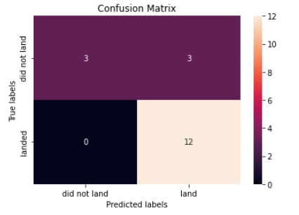
Confusion Matrix for Decision Tree
Although all models performed the same on the test data, the Decision Tree had the best on the validation step.
Predicted accurately
3/6 did not land
12/12 landed

Slide 45
Conclusions
KSC LC-39A had the best success rate
Orbits ES-L1, GEO, HEO, SSO, VLEO had best success rate
Lighter payloads have higher success rate
All models predict the same, but the decision tree classifier worked best on the validation data

Slide 46


